Slide 1
CELL STRUCTURE & FUNCTION
UNIT 4 CELLS: THE BASIC THEOR Y OF LIFE

Slide 2


MOVEMENT OF MATERIALS THROUGH THE CELL MEMBRANE
Discuss the processes of diffusion and osmosis.
Distinguish between passive and active transport.
Vocabulary: diffusion, selectively permeable, osmosis, facilitated diffusion, active transport

Slide 3

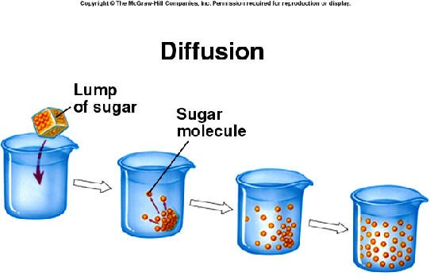
MOVEMENT OF MATERIALS THROUGH THE CELL MEMBRANE: DIFFUSION
diffusion – process by which molecules of a substance move from areas of higher concentration of that substance to areas of lower concentration

Slide 4

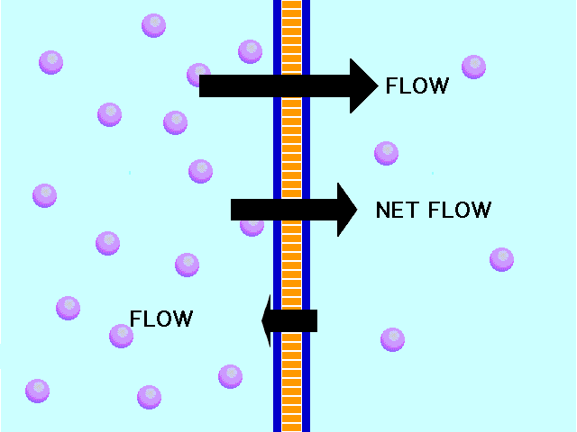
MOVEMENT OF MATERIALS THROUGH THE CELL MEMBRANE: DIFFUSION

Slide 5

MOVEMENT OF MATERIALS THROUGH THE CELL MEMBRANE: DIFFUSION
What factors determine whether diffusion occurs across a membrane?
Is there equilibrium between the inside & outside of the cell membrane?
If the answer is no then diffusion will occur.
How permeable is the membrane?
selectively permeable – description of a biological membrane that allows some substances to pass through but not others

Slide 6

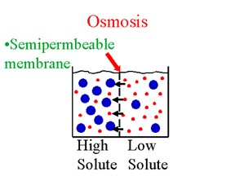
MOVEMENT OF MATERIALS THROUGH THE CELL MEMBRANE: OSMOSIS
osmosis – diffusion of water molecules through a selectively permeable membrane from an area of higher water concentration to an area of lower water concentration

Slide 7


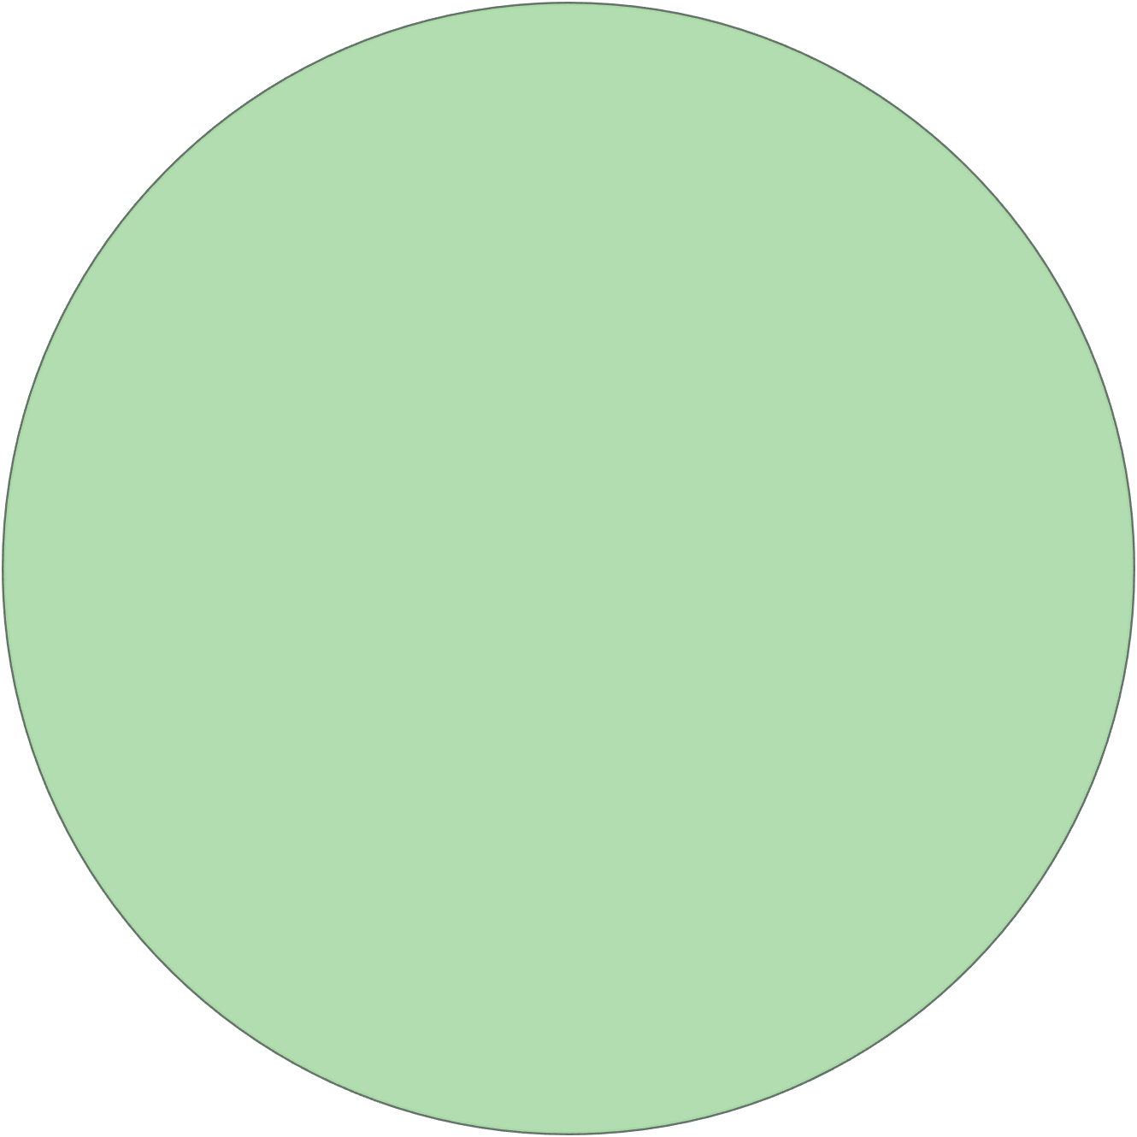











solvent and solute move
only solvent particles move
solute particles do not move
movement is through a semipermeable membrane
equalizes concentration of two solutions
particles move to equalize concentrations
no semipermeable membrane involved

Slide 8

MOVEMENT OF MATERIALS THROUGH THE CELL MEMBRANE: OSMOSIS
hypertonic solution – area of more solute
hypotonic solution – area of less solute
If semipermeable membrane separates hypotonic solution from hypertonic solution, water will move across membrane from hypotonic solution (less solute, more solvent) → hypertonic solution (more solute, less solvent)

Slide 9

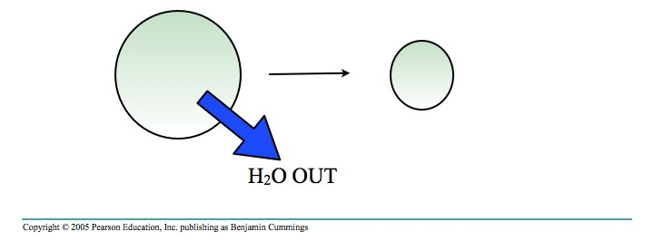
MOVEMENT OF MATERIALS THROUGH THE CELL MEMBRANE: OSMOSIS
If a solution is hypertonic
concentration of solutes is > it is inside cell
cell will lose water
cell will shrink

Slide 10

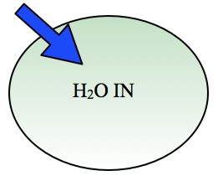
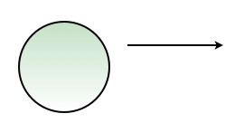
MOVEMENT OF MATERIALS THROUGH THE CELL MEMBRANE: OSMOSIS
If a solution is hypotonic
concentration of solutes outside is < it is inside cell
cell will gain water
cell will swell

Slide 11

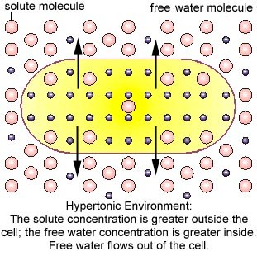
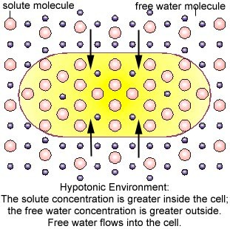
MOVEMENT OF MATERIALS THROUGH THE CELL MEMBRANE: OSMOSIS

Slide 12

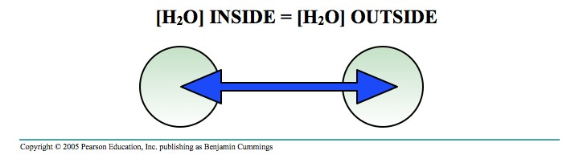
MOVEMENT OF MATERIALS THROUGH THE CELL MEMBRANE: OSMOSIS
If a solution is isotonic
concentration of solute outside is = inside cell
no net movement of water
in equilibrium
ideal environment for animal cells

Slide 13

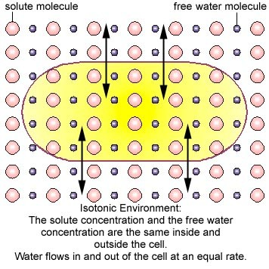
MOVEMENT OF MATERIALS THROUGH THE CELL MEMBRANE: OSMOSIS

Slide 14

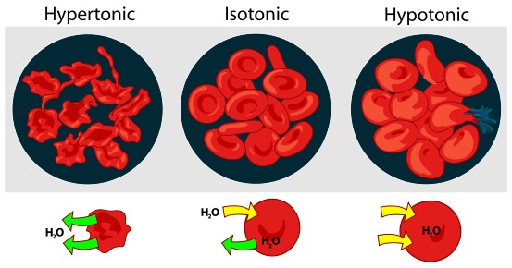
MOVEMENT OF MATERIALS THROUGH THE CELL MEMBRANE: OSMOSIS

Slide 15

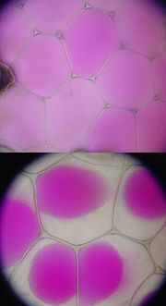
MOVEMENT OF MATERIALS THROUGH THE CELL MEMBRANE: DIFFUSION
plasmolysis – process in plant cells where cytoplasm pulls away from cell wall due to loss of water through osmosis. Occurs in a hypertonic solution.
cytolysis – can occur if cell is in a hypotonic solution resulting in a lower external osmotic pressure & a net flow of water into cell.

Slide 16

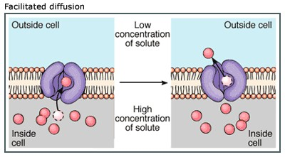
MOVEMENT OF MATERIALS THROUGH THE CELL MEMBRANE: FACILITATED DIFFUSION
facilitated diffusion – diffusion of materials across a cell membrane assisted by carrier molecules

Slide 17

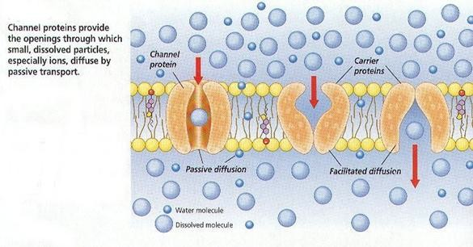
MOVEMENT OF MATERIALS THROUGH THE CELL MEMBRANE: FACILITATED DIFFUSION

Slide 18

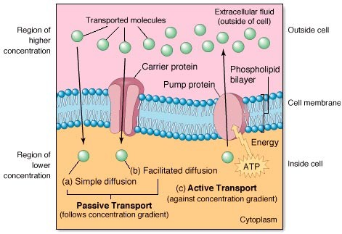
MOVEMENT OF MATERIALS THROUGH THE CELL MEMBRANE: ACTIVE TRANSPORT

Slide 19

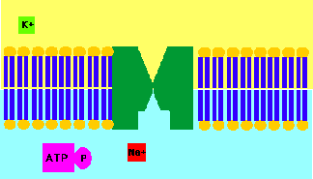
MOVEMENT OF MATERIALS THROUGH THE CELL MEMBRANE: ACTIVE TRANSPORT
active transport - energy-requiring process that moves material across a cell membrane against a concentration difference
2 types:
individual molecules are carried through membrane-associated pumps
large amounts of material are transported through movements of the cell membrane – Vesicular transport

Slide 20

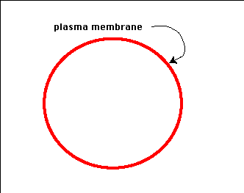
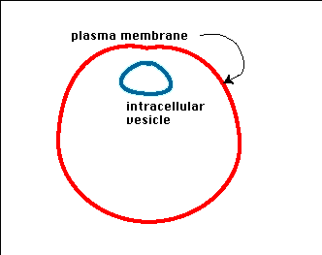
MOVEMENT OF MATERIALS THROUGH THE CELL MEMBRANE: ACTIVE TRANSPORT
large amounts of material are transported through movements of the cell membrane.
endocytosis – taking material into the cell by means of infolding, or pockets, of the cell membrane
phagocytosis – take in large particles (“eating”)
pinocytosis – take in liquid (“drinking”)
exocytosis – large molecules removed from the cell

Slide 21

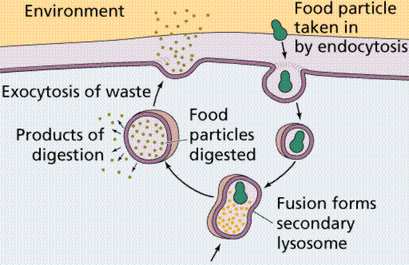
MOVEMENT OF MATERIALS THROUGH THE CELL MEMBRANE: ACTIVE TRANSPORT

Slide 22

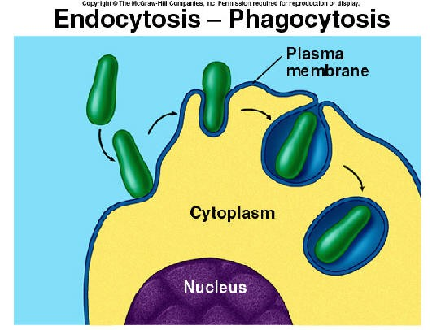
MOVEMENT OF MATERIALS THROUGH THE CELL MEMBRANE: ACTIVE TRANSPORT

Slide 23

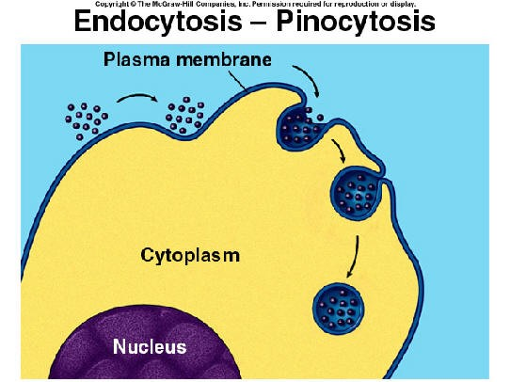
MOVEMENT OF MATERIALS THROUGH THE CELL MEMBRANE: ACTIVE TRANSPORT

Slide 24

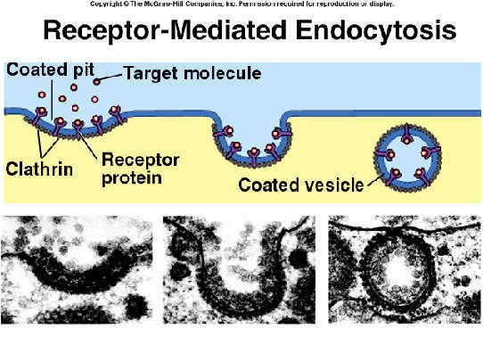
MOVEMENT OF MATERIALS THROUGH THE CELL MEMBRANE: ACTIVE TRANSPORT

Slide 25

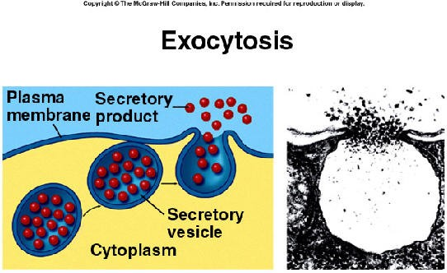
MOVEMENT OF MATERIALS THROUGH THE CELL MEMBRANE: ACTIVE TRANSPORT

Slide 26

MOVEMENT OF MATERIALS THROUGH THE CELL MEMBRANE: ACTIVE TRANSPORT

Slide 27

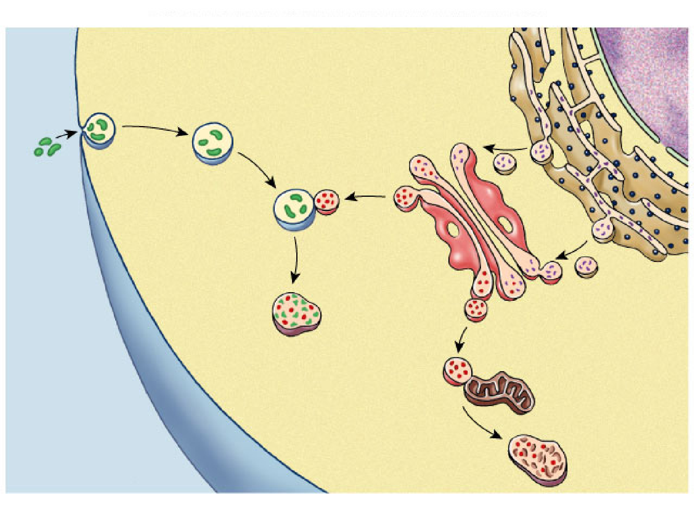
Cytoplasm
Copyright © The McGraw-Hill Companies, Inc. Permission required for reproduction or display.
Endoplasmic reticulum
Golgi apparatus
Food vesicle
Lysosomes
Transport vesicle
Old or damaged organelle
Plasma membrane
Digestion of food particles or cells
Breakdown of old organelle
Extracellular fluid

Slide 28

ACTIVE TRANSPORT PROCESSES
ENDOCYTOSIS
movement of molecules into the cell
phagocytosis –
“cell eating”
pinocytosis –
“cell drinking”
EXOCYTOSIS
movement of molecules out of the cell
molecules fuse with the cell membrane as move toward it, membrane pinches off & molecules spill out of cell

Slide 29

PASSIVE VS. ACTIVE TRANSPORT
PASSIVE
movement occurs naturally by kinetic energy
no energy required
molecules move from high concentration → low concentration across gradient
can occur in living or non-living systems
ACTIVE
energy is required for movement (ATP)
movement is from a low concentration → higher concentration against gradient
only occurs in living systems

Slide 30

CYTOPLASMIC ORGANELLES REVIEW QUESTIONS
1. cell membrane contains lipids
2. active transport, since ions move from lower concentration to higher concentration.
30

Slide 31

CYTOPLASMIC ORGANELLES REVIEW QUESTIONS
What is diffusion?
Why is osmosis a form of diffusion?
31

